Slide 1

Department of Information Technology
A.P. Shah Institute of Technology
G.B.Road, Kasarvadavli, Thane(W), Mumbai-400615
UNIVERSITY OF MUMBAI
Academic Year 2019-2020

Slide 2
A Project Report on
Chatbot for Efficient Resource Allocation and Management
Submitted in partial fulfillment of the degree of
Bachelor of Engineering(Sem-7)
in
INFORMATION TECHNOLOGY
By
Manasi Ghadge(16104019)
Anuja Dhumale(16104034)
Gitika Daki(16104005)
Under the Guidance of
Dr. Uttam .D. Kolekar

Slide 3
Project Conception and Initiation

Slide 4
1.1 Abstract
​ When considering an institution regardless, whether it is a school or university it is consequential that the students are edified in a congruous environment. This generalizes that the infrastructure should fascinate every requisite as cardinal or required by the students or the faculty in that environment.Present day process implies that all the work is done manually.

Slide 5
1.2 Objectives
To automate the process of manual allotment.
Overcome the manual errors that are ought to happen in the process.
Save time of the end users.

Slide 6
1.3 Literature Review
Automatic timetable generator Saritha M,Pranav Kiran Vaze,Pradeep,Mahesh N R International Journal of Advanced Research in Computer Science and Software Engineering, Volume 7, Issue 5, May 2017,ISSN: 2277 128X.
Timetable generation and Leave management system Shashikala K,Shruthi C R,Vinutha N,Roopalakshmi S SSN (Online) 2394-2320 International Journal of Engineering Research in Computer Science and Engineering(IJERCSE)Vol5,Issue6.
Automatic and eﬀective allocation for examination seats Neelkanth Sharma,Abhishek Mahale,Ashwini Andhale,Yogesh Joshi International Journal of Engineering Research and Management (IJERM) – Volume 3 Issue 5- May 2017.

Slide 7
Timetable Generator Albert Chai MengFatt , ChaiWeeKee , Lee Cheeheong PuahSuet Ni, Alvis Yeo Kok Yong, Mark Yeo Soon Hock, and Edmond C Prakash School of Computer Engineering Nanyang Technological University Singapore - 639 798.
Review of integrated applications with AIML based chatbot Md. Shahriare Satu, Md.Hasnat Parvez, Shamim-AL-Mamun 1st International Conference on Computer Information Engineering, 26-27 November,2015.

Slide 8
1.4 Problem Definition
To provide a web based application for eﬃcient allotment of infrastructure.”Chatbot For Eﬃcient Resource Allocation And Management” will be integrated with an AI chatbot for utilized interaction.

Slide 9
1.5 Scope
Proposed System will provide comfort to the manpower and will avoid hamper in academics.
Provides with an AI Chatbot in runtime of academics.
It will avoid inconsistencies visually perceiving that no lab session is missed due to any reason by providing alternate infrastructure options.
Additionally features provided like reservation and dynamic allocation due to any activities.

Slide 10
1.6 Technology stack
Chatbot - Python
Website - HTML, CSS
Database - PHP, MySQL

Slide 11
1.7 Benefits for environment & Society
Save time invested by faculties to find lab manually.
Reduce manpower.
Provide efficient infrastructure allotment.

Slide 12
2. Project Design

Slide 13
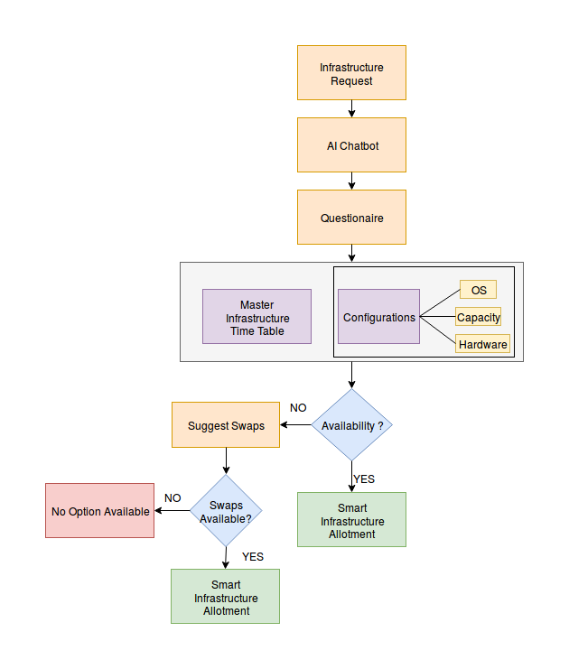
2.1 Proposed System

Slide 14
2.2 Design(Flow Of Modules)
Infrastructure request made through
Chatbot followed by requirements are
taken from user and accordingly
appropriate infrastructure is alloted.

Slide 15
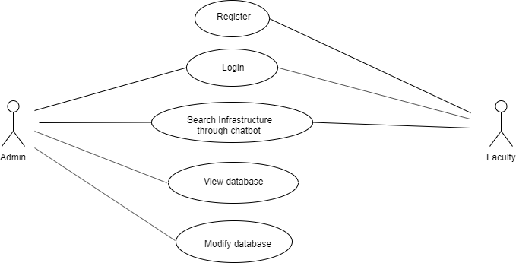
2.3 Description Of Use Case

Slide 16
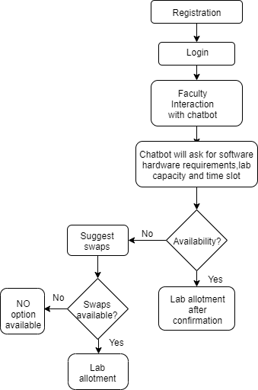
2.4 Activity diagram

Slide 17
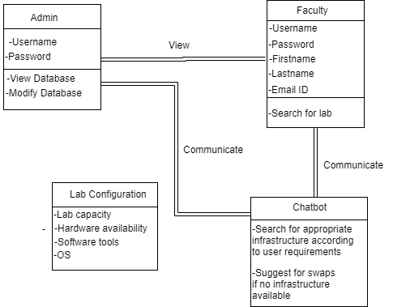
2.5 Class Diagram

Slide 18
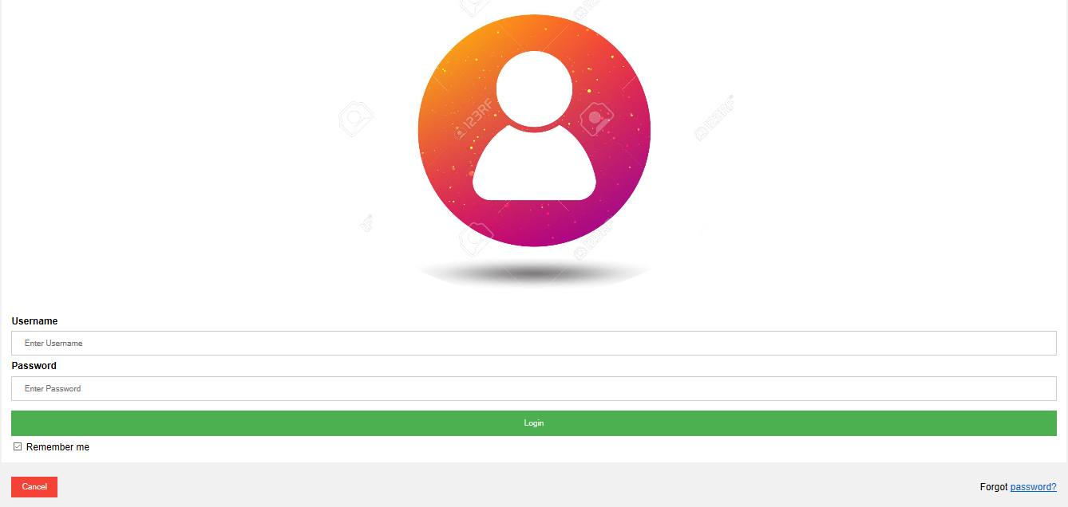
2.6 Module-1

Slide 19
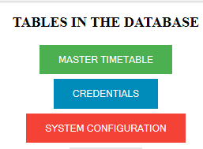
Module-2

Slide 20
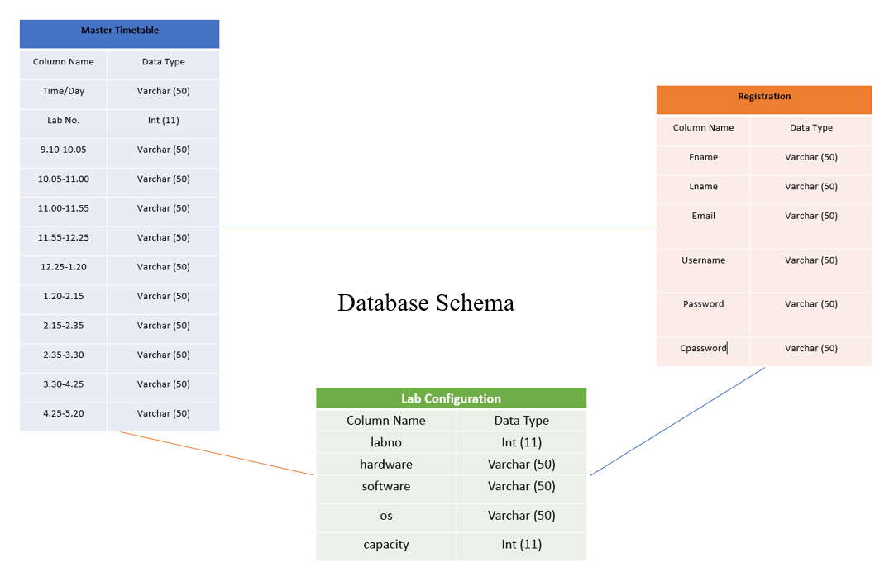
Module-n

Slide 21
2.7 References
1. Saritha M, Pranav Kiran Vaze, Pradeep, Mahesh N R,on”Automatic Time Table Generator”,International Journal of Advanced Research in Computer Science and Software Engineering,Volume7,Issue5,May2017,ISSN: 2277 128X.
2. Shashikala K,Shruthi C R,Vinutha N,Roopalakshmi S on“Timetable Generation and Leave Management System”,ISSN(Online)2394-2320 International Journal of Engineering Research in Computer Science and Engineering (IJERCSE) Vol 5, Issue 6, June 2018.

Slide 22
3. Neelkanth Sharma, Abhishek Mahale, Ashwini Andhale,Yogesh Joshi on “Automatic and Effective Allocation for Examination Seats using Android Application” International Journal of Engineering Research and Management (IJERM) – Volume 3 Issue 5- May 2017.
4. Md.Shahraire Satu, Md. Hasnat P,Shamim-AI-Mamun on Review of integrated applications with AIML based chatbot 1st International Conference on Computer & Information Engineering, 26-27 November,2015.

Slide 23
3.Planning for next semester

Slide 24
Planning
Creation of AI based chatbot using python.
Integrating it with web based application.

Slide 25
Thank You

